Slide 1
Spatial Awareness Program
Devansh Shah , Rishabh Leelchand, Harry Jia, James Hanna

Slide 2
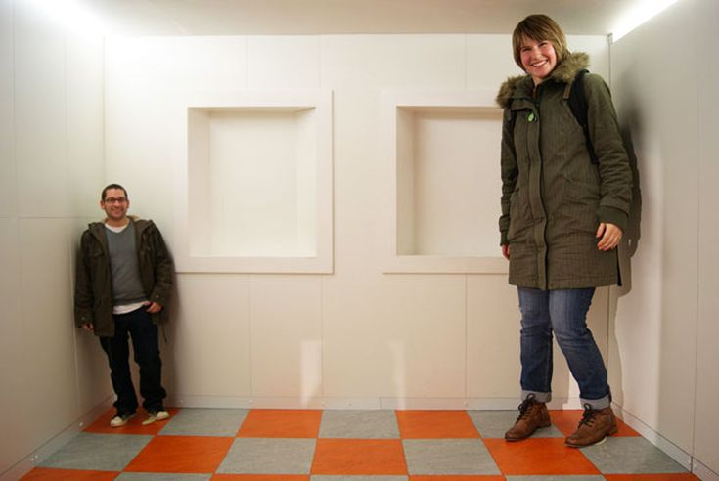
Introduction to the Problem
Spatial awareness refers to one’s ability to aware of objects in their surroundings and their body relative to the objects. It is essential for orientation and movement throughout surroundings.
While all senses are required to develop spatial awareness, vision contributes the largest by allowing individuals to visually perceive their surroundings
A common issue for individuals with vision impairments is their spatial awareness can be hindered from reduced distance/depth perception from the onset of myopia & presbyopia, to no vision perception due to full blindness.
Current aides for this problem include the use of walking sticks, touching objects, listening for surroundings and muscle memory in familiar environments such as walkways in ones’ household.

Slide 3
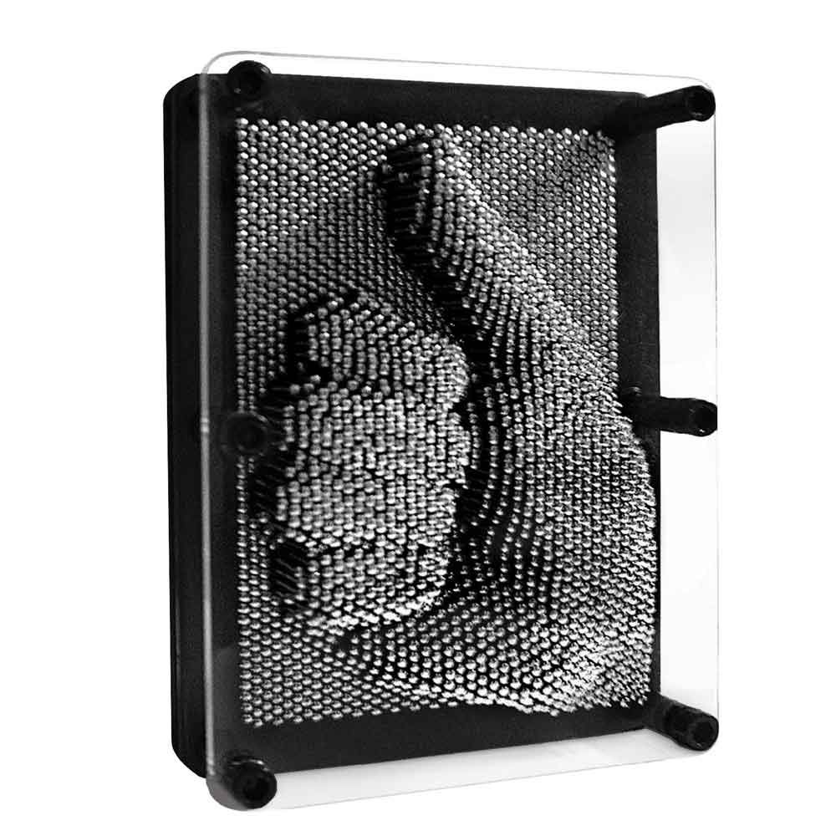
Introduction to the Solution
The Spatial Awareness Program aims to provide a quick and efficient solution that trades vision for touch to develop an individuals’ spatial awareness.
The program utilizes a LiDAR laser to scan a room to obtain distance data, for a matrix of data points in front of the individual. The program will then reproduce the scan onto a 3D display that can be felt by the user to allow them to interpret the surrounding surrounding environment, like pin art.
The model we have developed performs this action by utilizing the servos to position the LiDAR at data points and take measurements which are then stored in a matrix. The matrix is then serialized and developed into a visual display in Python. During the scan, the accelerometer monitors the orientation to guarantee a steady scan is conducted while being held by the user.

Slide 4
Main Modules of the Solution
LiDAR & Servomotor Operation
Orientation of PTU Module during scans
Serialisation of Output Data
Display of Data as a Python Image

Slide 5
LiDAR & Servomotor Operation
Servomotor operation is controlled by sending a 20 ms PWM signal to pins 5 & 7 of Port T. The sub-functions 'horizontalShift' and 'verticalShift' control these actions by taking the position as an angular position, in degrees, which is then converted into a duty cycle ON period that can replicate the angle in the servomotor.
LiDAR operation is controlled by utilising the timer input counter. The pulse width of the LiDAR signal is counted after the trigger signal is sent via PHO. The pulse width is then converted to a length value that is returned and stored in the output.
Both the LiDAR and Servomotor are operated in the main body of the scanRoom function inside a nested loop, the nested loop works to create a square-matrix of positions to move the servo through as data points. The (x,y) positions are converted to angles and then used as inputs to the servo position functions, the LiDAR distance value is then taken at each position and stored in a matrix to be returned to the main function. Prior to each position, the orientation module is called to check that the PTU position has not changed to ensure a consistent scan is completed while being held by the user.

Slide 6
Orientation Regulation of System
The Orientation of the PTU Module is done by initialising the IIC sensor. The main component of the IIC sensor that will be used is the accelerometer, which will be converted into the primary components: Pitch and Roll.
The Orientation module is incorporated in the checkOrientation function, which takes in the current x and y angles of the Lidar Servos. It then sets the minimum and maximum angles that the Lidar sensor can stay in range before the Lidar Sensor loop stops and pauses. The function then goes into a loop in which it reads the accelerometer reading, and then calculates the Pitch and Roll using appropriate equations. It then checks if the angle is within the range of +-10 degrees. If it is then it exits the loop and returns back to the main function.
The checkOrientation function is called after every servo movement of the Lidar sensor. This allows a moderately accurate check for orientation when taken into account with the speed of the main function loop.

Slide 7
Serialisation of Output
One scan of a room involves positioning PTU at chosen 64 different positions by adjusting horizontal and vertical angles. At each of these points, lidar sensor gives a distance measurement. 64 of these points is used to create a 8x8 matrix to give a spatial representation of the room. The scanRoom() function creates one scan of the room as described, during the scan each data point is sent via serial port in this format: A|B||C|D||| A,B,C,D represent floating point numbers representing distance measurement from lidar sensor. A singular pipe symbol (|) is used to separate the numerical values, two pipe symbols in a row indicate new row in matrix, and finally three pipes in a row indicate end of transmission for this particular scan. The above serial data represents matrix: [[A,B],[C,D]]
This format for serial data transmission was to allow flexibility in code for different resolutions and aspect rations of the spatial scan of room, not just an 8x8 grid. The serial data is sent over via SCI1 port. scanRoom() function is continually called to create continuous scan of room.

Slide 8
Display of Output in Python
In this part, the scan image of the room will be present as a 8x8 heatmap (64 pixel). The degree of heat will be shown by grey. Each pixel of the image represents the distance between the Lidar to the obstacles (usually the wall). So that the heatmap can shows the image of a rough room outline drawing.
Using a infinite loop in the plot model. When the data received from the serial port is keeping changing, which means the machine is scanning the code continuously, the hap shown by python will also follows that.

Slide 9
Testing Procedures: Modular Testing
LiDAR Scanner: Testing of LiDAR checks that it can measure accurately and provide consistent values on a loop. To test this module, place a black sheet a known distance away from the LiDAR and run the function testLidar(); inside a loop. Check in memory that the correct value is returned for several iterations.
Servomotors: Testing of servomotors ensures accurate positioning is achieved when a value is provided. This is tested by running the servomotor functions with a known angle input and checking that the angle is replicated in the PTU.
Orientation: Accelerometer is tested by running the error functions provided by the IIC.
Serialization: Testing of serialization process requires inputting an array of values into the serialization module and checking they are returned correctly in the serial window of SCI1.
Python Output: This is tested by initializing a random matrix of values that are read by the python code and checking that an image can be produced. The python serial is tested by sending a series of values to the serial port and checking that they are printed in the python shell.

Slide 10
Integration Testing
Testing to ensure that all modules work together:
Place the scanRoom() function into the main program and run to check that it continues to operate correctly.
Integrate the checkOrientation() function and call inside the scanRoom loop. Repeat test to ensure calculations are unaffected.
Integrate serialization module then run with a serial input from SCI1, observe in the terminal that the correct values and format are sent to the terminal via serial.
Integrate python module, ensure that no connectivity issues arise, input values are formatted and an image continues to be produced.

Slide 11
System Testing
After integration and confirmation that all modules work together, simulate the entire system by first running the python code to begin waiting on a serial input then running the CodeWarrior program.
A complete scan should be executed with an image of the room produced inside python.

Slide 12
Demonstration of Model

